Slide 1

Grade 12
Educational Planning
2024-2025

Slide 2
Graduation Requirements
30 credits (18 compulsory & 12 optional)
4 English
3 Math
2 Science
1 Geography
1 History
1 French
1 Physical Education
1 Arts (Dance, Music, Media or Visual Art)
.5 Career Studies & .5 Civics
3 Additional Compulsory Courses
+ 40 hours of Community Service
+ Grade 10 EQAO
Literacy Test
English / Language / Soc Science / World Studies / Co-op / Guid
Phys Ed / Arts / Business / Co-op / French
Senior Science / Technology / Co-op / French

Slide 3
Compulsory Courses
English
  University
  College
  Workplace
ENG 4U1 ENG 4C1 ENG 4E1
+ 6 or 7 options

Slide 4
UNIVERSITY/ COLLEGE DEGREES
Pathways
√ All UNIVERSITY & COLLEGE DEGREE programs require:
ENG 4U + 5 other Grade 12 courses at the U/M level
√ Subject-specific courses may also be required
ie. Math, Biology, Chemistry, Physics, etc.
√ Check program pre-requisites at
www.ontariouniversitiesinfo.ca
√ University program books are available in Guidance

Slide 5

ontariouniversitiesinfo.ca

Slide 6

Admission
Requirements
Wilfrid Laurier University
Bachelor of Business Administration
ENG 4U at 70%
MHF4U at 70%
1 of MCV4U or MDM4U at 60%
+3 Grade 12 U/M Courses
High 80s average

Slide 7
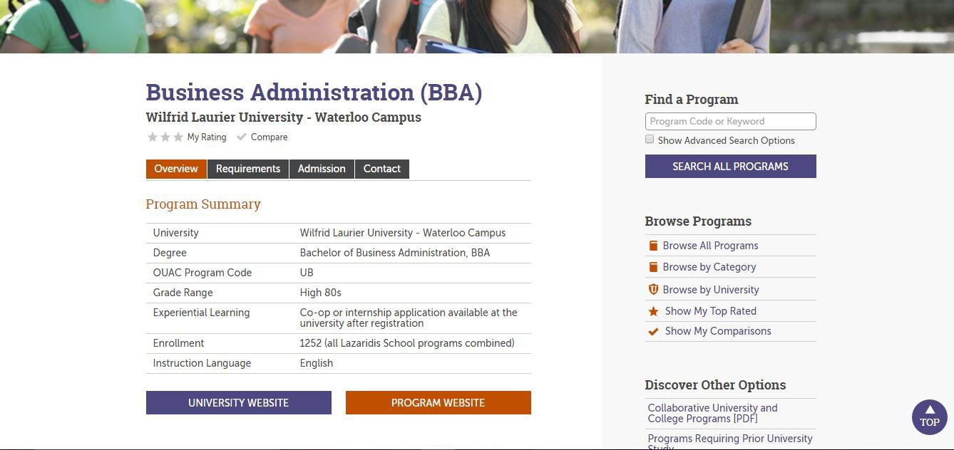
Wilfrid Laurier University
BBA
Additional Admission Criteria
Competitive admission range (mean entrance average of last year's admitted students): Low 90s

Slide 8
COLLEGE DIPLOMA
√ All COLLEGE programs require:
ENG 4C/U +
other Grade 11 or 12 courses at C/U/M
√ Subject-specific courses may also be required ie. Math, Biology, Chemistry, Physics, etc.
√ Check program pre-requisites at
www.ontariocolleges.ca

Slide 9

ontariocolleges.ca

Slide 10

Admission
Requirements
Humber College
Pharmacy Technician Practical Nursing
Eng 4C or 4U
Gr.12 C/U Math
Gr.11 C/U or Gr.12 U BIO Gr.11 U or Gr.12 C/U CHEM

Slide 11
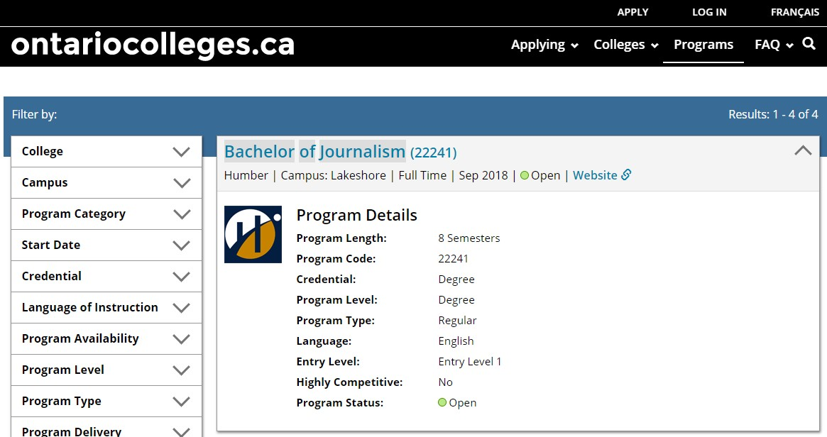
Degrees available
at Ontario Colleges

Slide 12
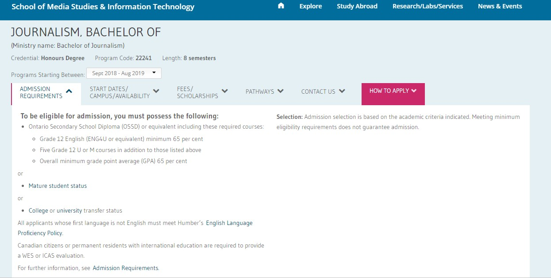

Bachelor of Journalism
at Humber College

Slide 13

Have a goal...
not sure how to get there?
Explore
Guide to credit transfer between
College and University
Learn about the possible direct AND indirect routes to your goals through Ontario’s Colleges and Universities

Slide 14
WORKPLACE
YMCA Employment Services immigrant-services
Human Resources Canada
Can Learn
Rotary Youth Exchange Canadian Forces
Job Search Sites
ymcagta.org/employment-and-
hrsdc.gc.ca canlearn.ca/eng/index.shtml rotary.org
forces.ca monster.ca workopolis.ca

Slide 15
APPRENTICESHIP
√ Most APPRENTICESHIPS require an
Ontario Secondary School Diploma
√ Subject-specific courses may also be required
ie. Electrician = Grade 12 ENG, MATH & PHYSICS
Auto Service Technician = Grade 12 ENG & MATH
√ Students can begin an apprenticeship 3 different ways:
Ontario Youth Apprenticeship Program
Directly through a registered employer
A Pre-Trade Program at College

Slide 16
Why Skilled Trades?
Gain skills for employment and for personal use
Feel the satisfaction of building, fixing,
creating, doing
Learn by doing
Avoid university/college debt
Earn while you learn
Many, many job vacancies in these areas in
the near future and right now!

Slide 17
But I don’t know what I
HELP!
want to do!
Not sure which path to take?
Not sure where you want to end up?
√ Start here! myBlueprint
√ Who Am I?
√ See your Guidance Counsellor

Slide 18



Have you considered Co-op?
Help answer the question: “what are you going to do after high school?”
Learn about yourself
Gain skills and know-how about the
workplace
Network with future employers

Slide 19
Dual Credits
with various local Ontario Colleges
Earn high school credits AND
college credits at the same time
Many opportunities available in a variety of fields
See your Guidance Counsellor or a
Co-op Teacher for more information

Slide 20
The Course Selection Process
Review the courses offered for 2024-2025 on myBlueprint.ca/dpcdsb
Courses are due by
January 10th, 2024 !

Slide 21

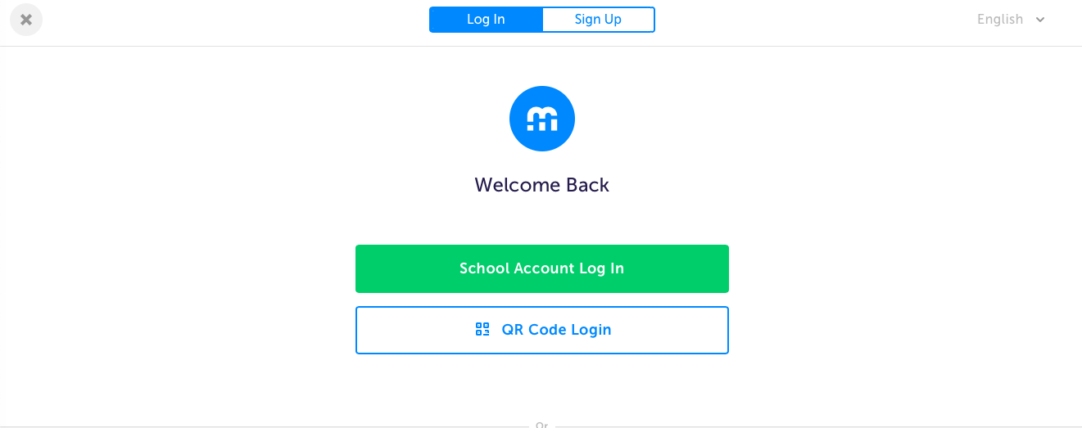
Access to myBlueprint is through BYOD
You MUST use CHROME!

Slide 22
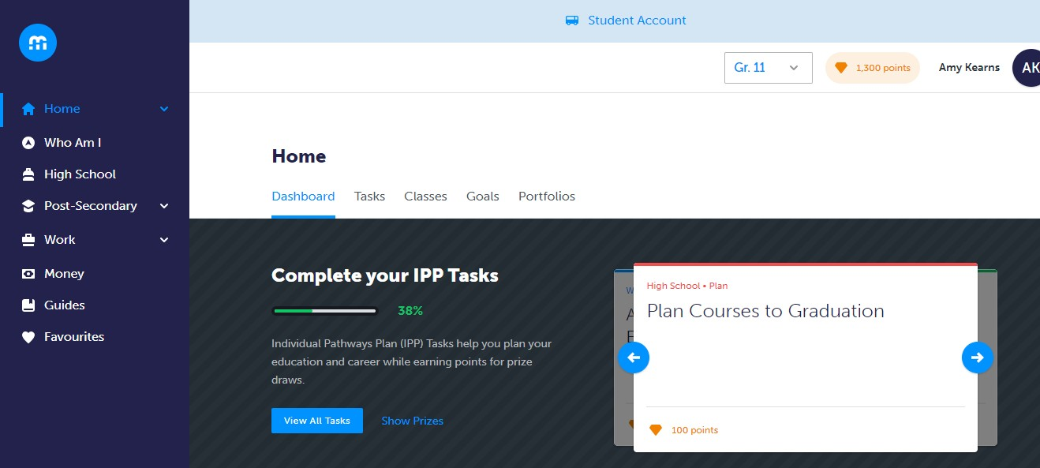
Plan Your Courses Using
myBlueprint’s High School Planner

Slide 23
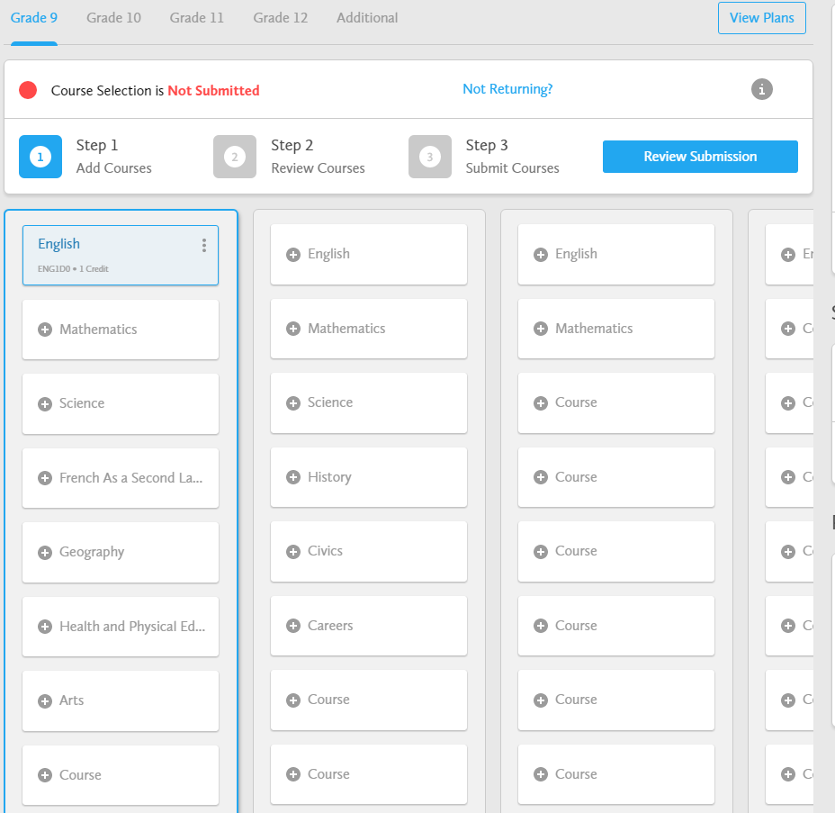
Course Selection Process
Choose courses using the suggested subjects

Slide 24
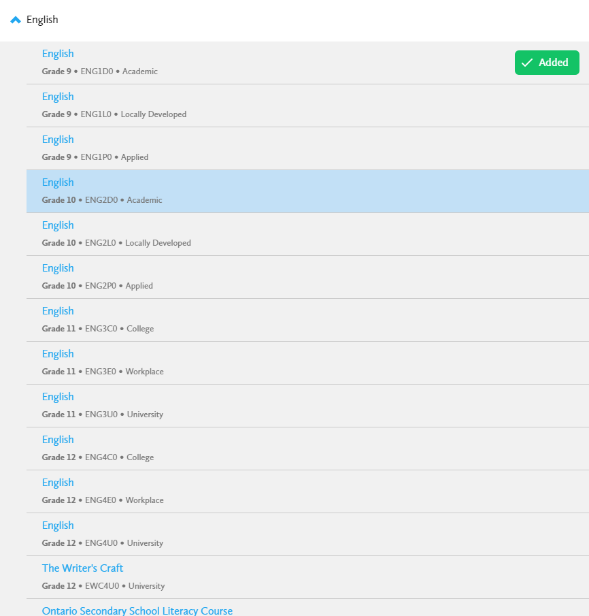


Select the Grade and Subject
Sort the courses by subject

Slide 25
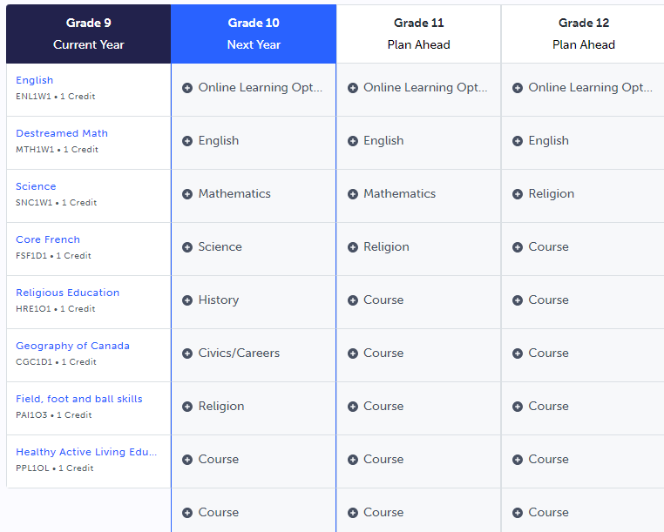
eLearning Opt-Out
To OPT-OUT of the 2 Ministry mandated eLearning courses, please add the option at the top of your grade 12 year.

Slide 26
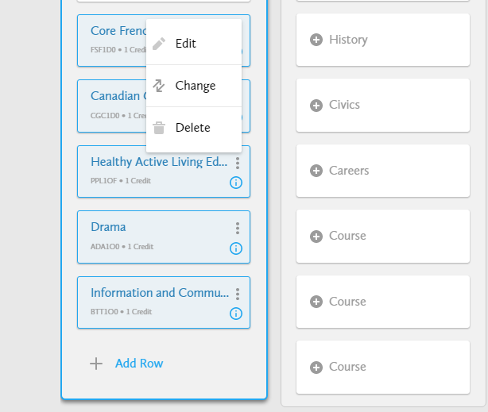
Modifying Choices
Changing or Deleting selections, select the three grey dots
Pop up box will appear with choices

Slide 27

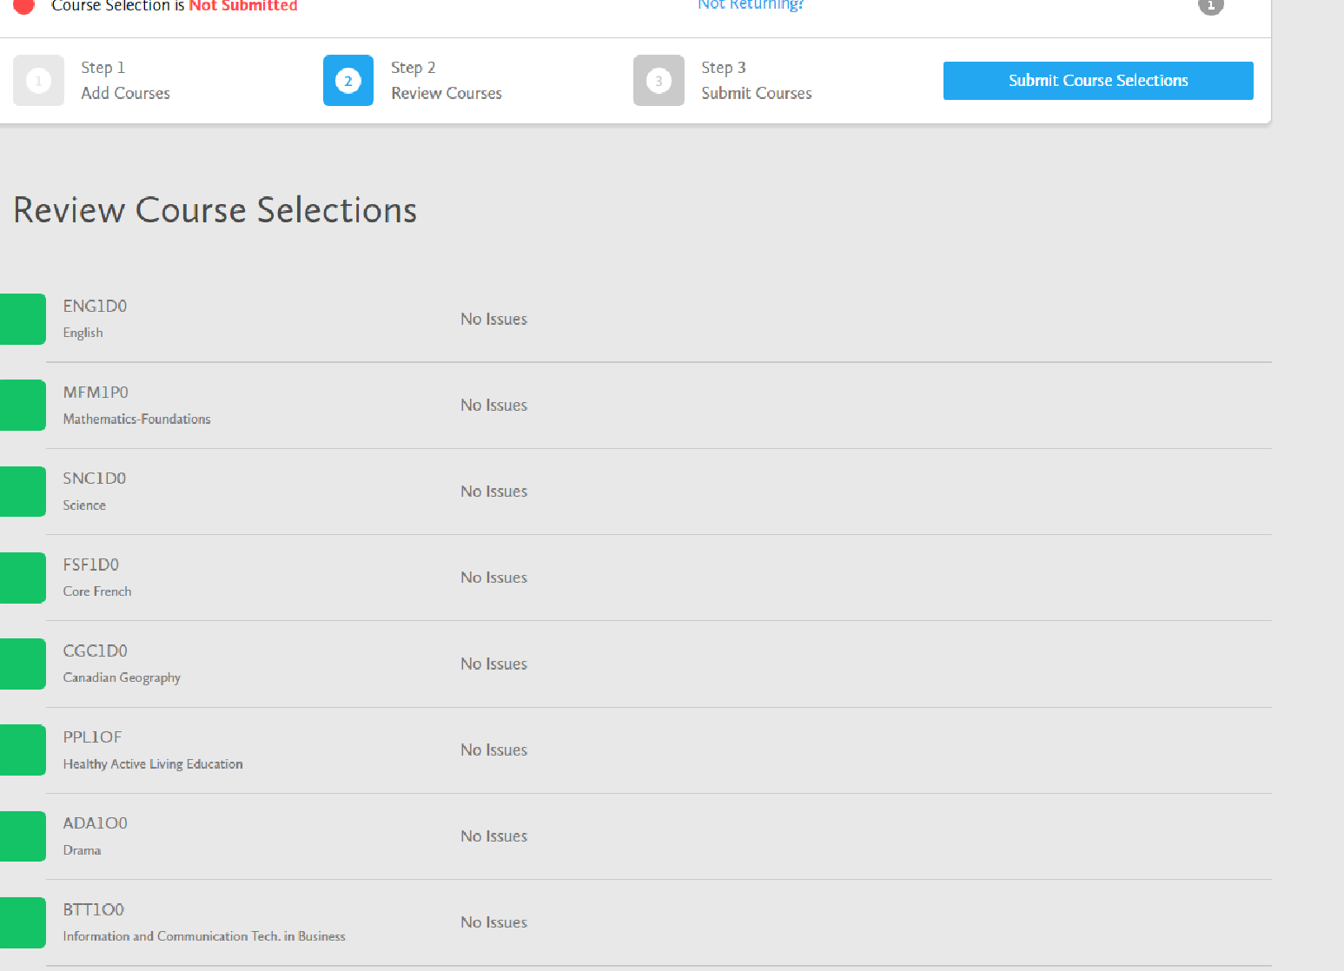
Review Course Selection (Step 2)
Review details and issues

Slide 28
Review Course Selection (Step 2)
Issues that are identified can still be updated BEFORE YOU SUBMIT!
Not all issues that are identified need to be altered.
e.g. ESLBO does not need ESLAO as a prerequisite.
You can add comments to the plan, such as Summer School plans.

Slide 29



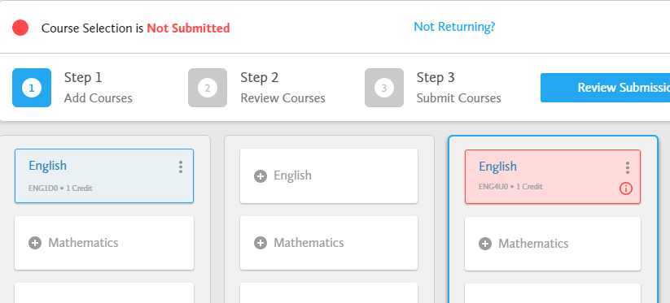
Missing Prerequisite Notification
Missing prerequisites have a red indicator and are highlighted in Pink
Please review your course prerequisites.
You must complete a Pre-requisite Waiver form for all missing pre-requisites (except ESL)
See your Guidance Counsellor to develop a plan.

Slide 30
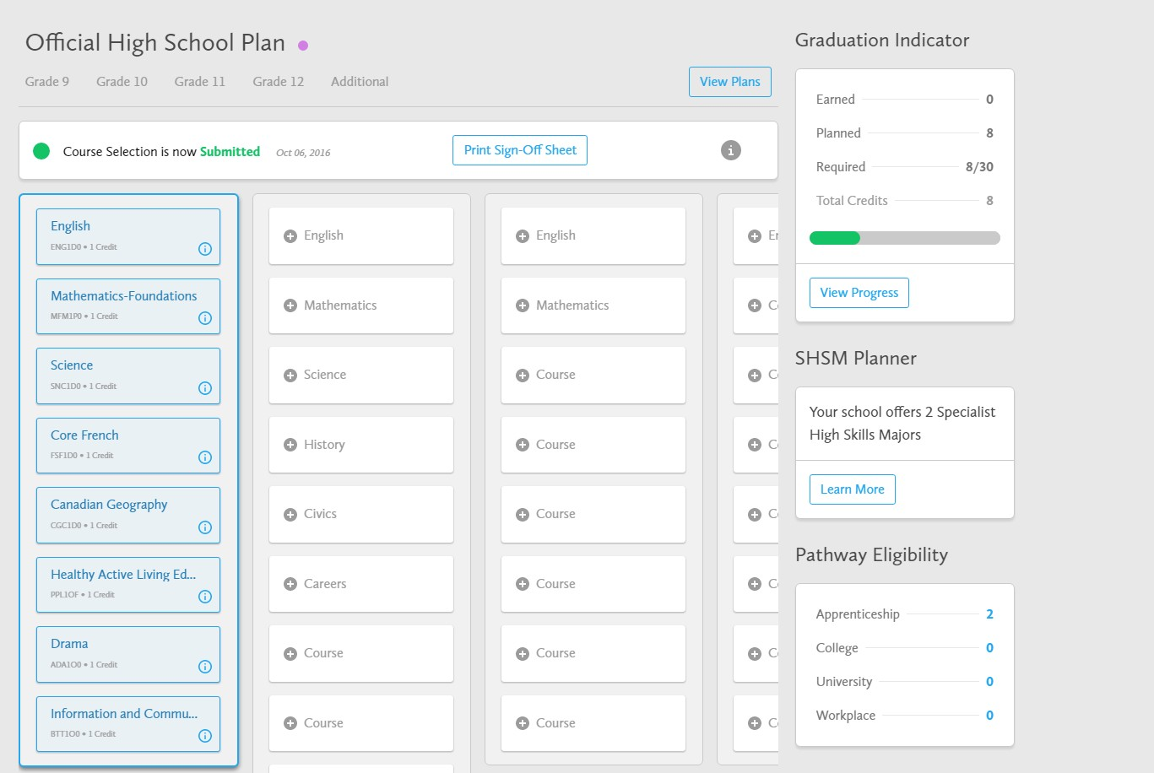
Submit Course Selection (Step 3)

Slide 31
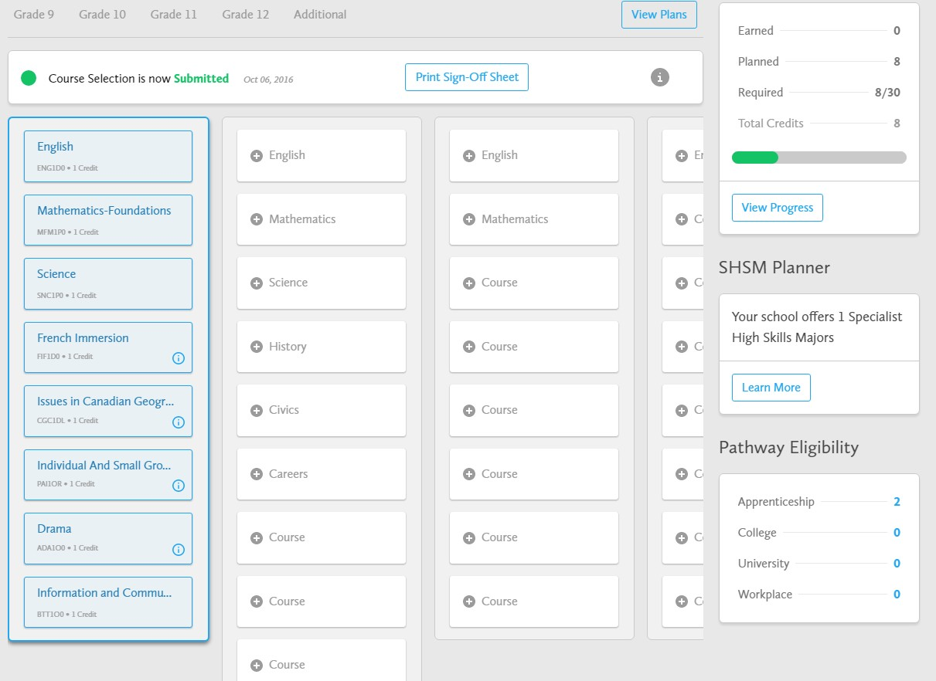



Print Sign-Off Sheet
(Verification Form)
Sign-off Sheet must be selected (it is not automatic)
The Sign-off Sheet can be printed multiple times.

Slide 32
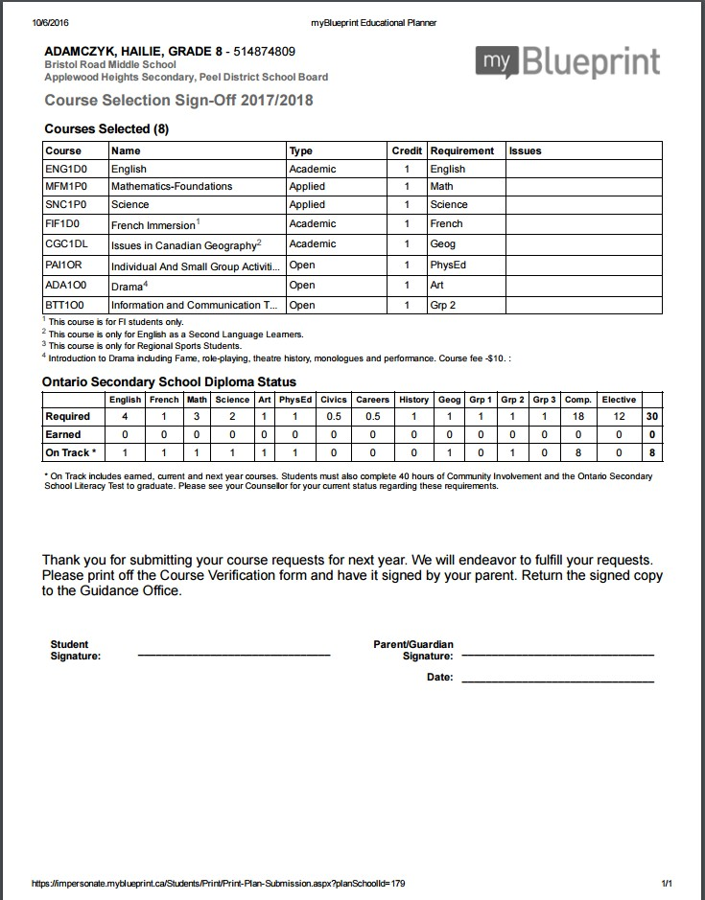
Verification Form

Slide 33
Plan, plan, plan and then
SUBMIT!
Students are responsible for going to myBlueprint and choosing their courses by January 10th, 2024
Courses only run with sufficient
enrollment

Slide 34

Regional Programs & SHSM
You are responsible for choosing the appropriate courses for your SHSM program to ensure you fulfill the Ministry requirements

Slide 35

If you are 100% certain that you are going to take a course in summer school, do not choose it as part of your plan for next year in myBlueprint

Slide 36
Questions?
Visit the Departments for information on specific courses
Speak to your teachers
Speak to your parents/guardians
Speak to your peers
Research

Slide 37

Still Have Questions?
A-C Mrs. Nizic
D-F Mr. DeMarco
G-N Ms. Johnston
O-Z Mrs. Lees
Book an appointment with your counsellor ☺

