Slide 1


Course Selection Process
Grade 10 to 11
St. Martin C.S.S
2024-2025

Slide 2

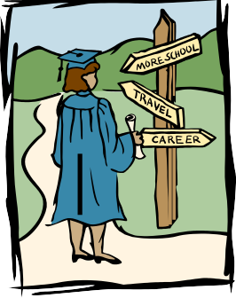
The Pathways
Students in Ontario have many options for post secondary training
They can choose from colleges, universities, multiple apprenticeship opportunities and on the job training programs

Slide 3

The Apprenticeship Pathway
A “hands-on” training program that has existed for many years
One of Ontario’s best kept secrets of post-secondary training
www.apprenticesearch.com

Slide 4


The College Pathway
College programs provide a valuable combination of academic and practical/technical skilled training for a specific career
There are almost 600 programs to choose from at Ontario’s colleges, including Business, Biomedical Technology, Computer Animation, Engineering Technology, Paramedic, and Social Worker
Colleges now offer Certificates, Diplomas, Degrees and articulation or bridge agreements with Universities
Visit www.ontariocolleges.ca to begin doing some preliminary research

Slide 5
College Pathway Requirements
All COLLEGE programs require:
ENG 4C/U +
Other Grade 11 or 12 courses at C/U/M
Subject-specific courses may also be required ie. Math, Biology, Chemistry, Physics, etc.
Check program pre-requisites at
www.ontariocolleges.ca

Slide 6
The University Pathway
University programs provide theoretical academic training
www.ontariouniversitiesinfo.ca
In general, there are 5 main types of programs at most universities:
Arts/Humanities/Social Sciences
Life/Health Sciences
Physical/Engineering Sciences
Business/Commerce
Professional programs

Slide 7
University and College Degree Pathways
Courses
All degree programs require ENG 4U1 + 5 other Grade 12 U/M level courses
Pre-Requisite Courses
Specific programs will require specific Grade 12 U/M pre-requisite courses (MCV4U, MHF4U, SPH4U, etc.)
Research
Visit www.ontariouniversitiesinfo.ca to start doing your research

Slide 8
COURSE TYPES
Plan
As well as choosing specific courses, you also need to choose appropriate levels
College (C)
Mixed (M)
Open (O)
University (U)
Talk
Talk to your parents/teachers/guidance counsellor
Look
Look at PREREQUISITES for future postsecondary planning

Slide 9


Cooperative Education
A great way to try out a job
  You can earn either 2 or 4 credits in a semester
  OYAP program for skilled trades is an option
  Be sure to visit the COOP office for placement opportunities and applications
  SHSM students MUST take a 2 credit COOP in grade 11 or 12

Slide 10
Dual Credit Programs
Earn maximum of 4 high school credits AND college credits at the same time
Many opportunities available in a variety of fields at Humber, George Brown, Sheridan, Seneca
  e.g. Digital Arts/Game Design, Criminal Justice, Animation, Drafting, Web Development, TV/News Broadcasting, Psychology, & various trades
Free tuition, free books, subsidized transportation, subsidized safety boots for trades
See Guidance or Co-op Dept. for more information

Slide 11
Credit Tracking
By the end of your grade 10 year, you should have 16 earned credits
Grade 11 is the year you will begin to select more elective credits as most students will only need the 3 compulsory courses
Continue to work towards earning your 40 hours of community service
Provincial Literacy Test OSSLT (if you are unsuccessful in grade 10, you will have the opportunity to rewrite it in your grade 11 year or take the OLC course)
Grade 11 students MUST take 8 courses ***NO SPARES***

Slide 12

Summer School
If you are 100% certain that you are going to take a course in summer school, do not choose it as part of your plan for next year in myBlueprint
If you plan to take a compulsory subject in summer school, please use the comments section in myBlueprint to indicate this
Summer school forms come out in the spring and will be posted to the google classroom and in the guidance office

Slide 13
Specialist High Skills Major
SHSM is a program where Gr. 11 and 12 students focus their learning on a career area of interest
These programs assist students in their transition from secondary school to apprenticeship, college, university or the workplace.
Students gain sector specific skills and knowledge in career focused learning environments.
There are 2 SHSM programs at St. Martin
  Sports
  Hospitality and Tourism

Slide 14

Specialist High Skills Major
You are responsible for choosing the appropriate courses for your SHSM program to ensure you fulfill the requirements. These can be tracked in myBlueprint
Speak with your Guidance Counsellor if you have questions

Slide 15
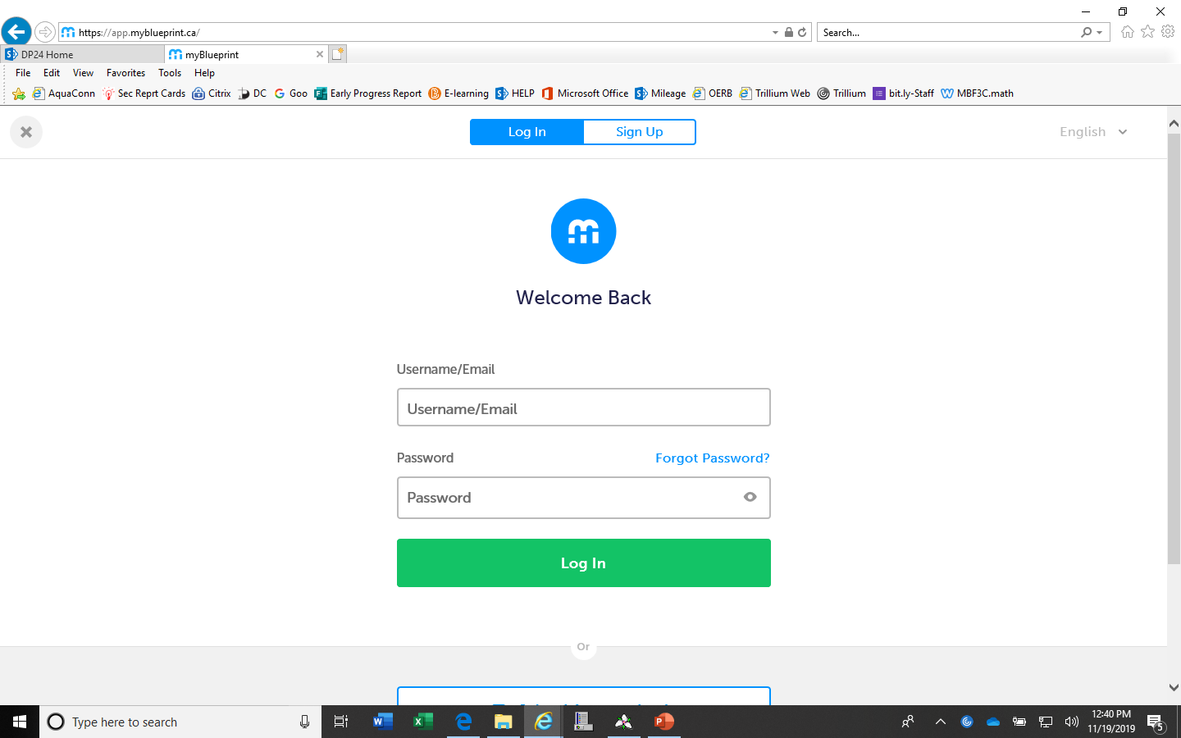

Access to myBlueprint is through your student Dashboard
You MUST use CHROME

Slide 16
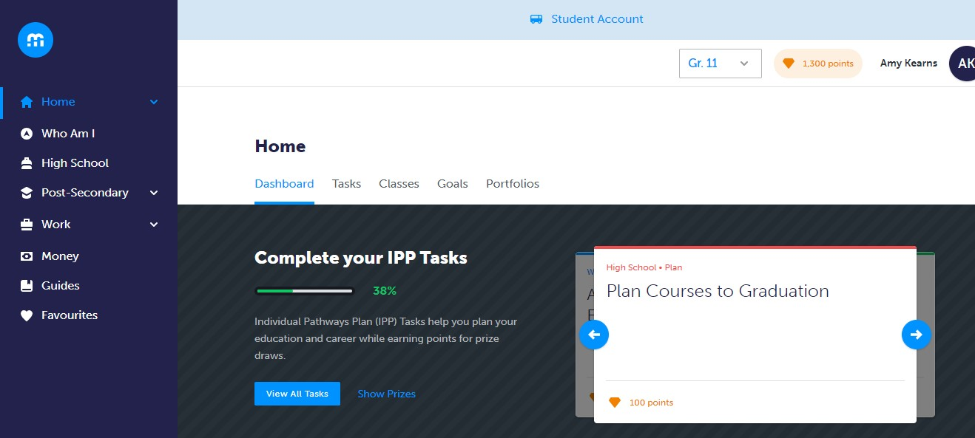
Plan Your Courses Using
myBlueprint’s High School Planner

Slide 17
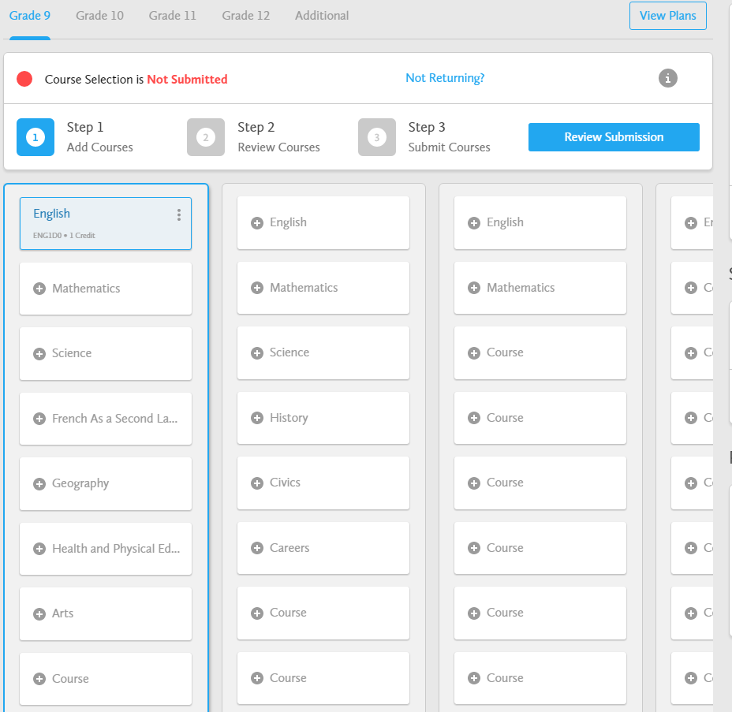
Course Selection Process
Choose courses using the suggested subjects

Slide 18
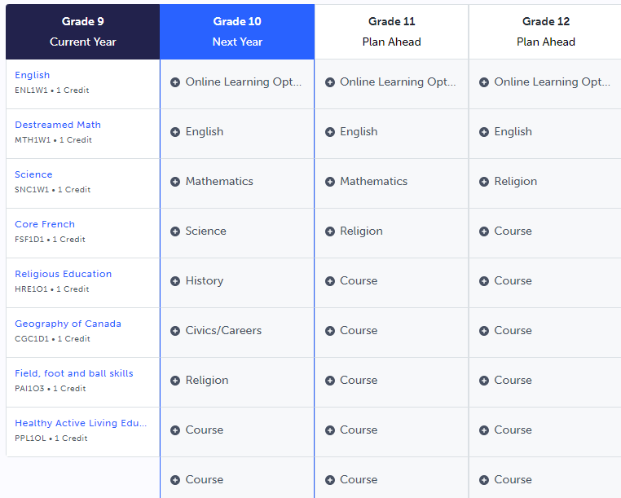
eLearning Opt-Out
To OPT-OUT of the 2 Ministry mandated eLearning courses, please add the option at the top of your grade 11 year.

Slide 19
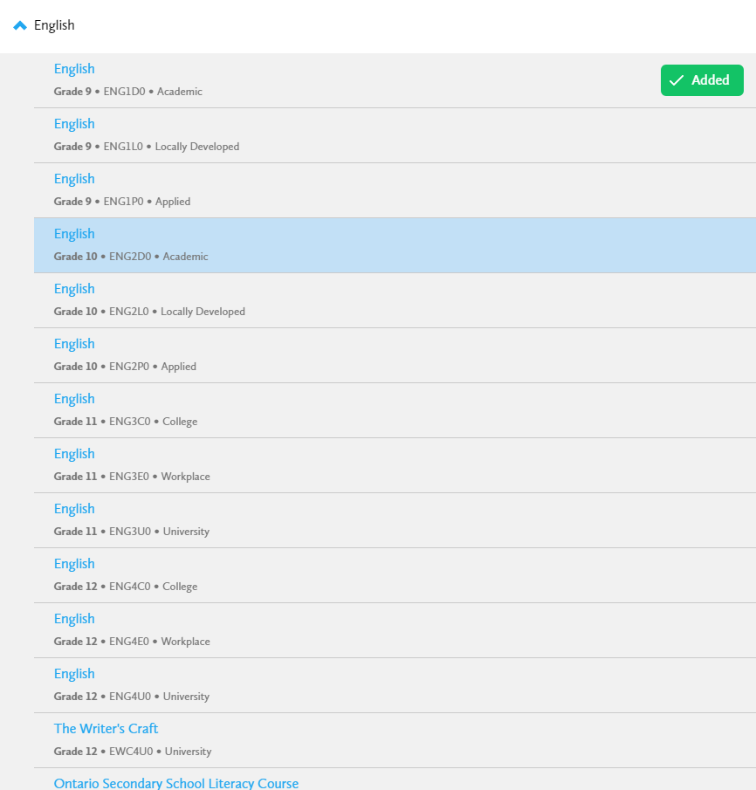

Select the Grade and Subject
Sort the courses by subject

Slide 20
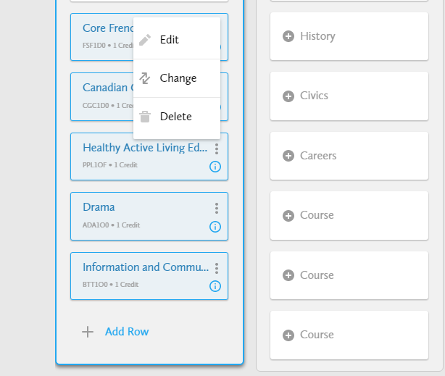
Modifying Choices
Changing or Deleting selections, select the three grey dots
Pop up box will appear with choices

Slide 21
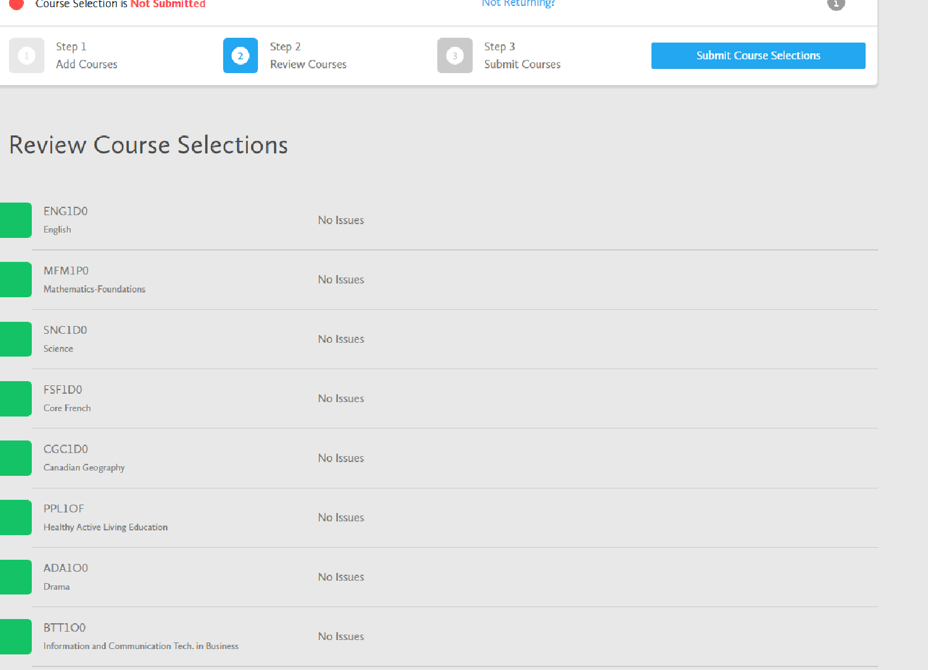
Review Course Selection (Step 2)
Review details and issues

Slide 22
Review Course Selection (Step 2)
Issues that are identified can still be updated BEFORE YOU SUBMIT!
Not all issues that are identified need to be altered
    e.g. ESLBO does not need ESLAO as a prerequisite.
You can add comments to the plan, such as Summer School

Slide 23



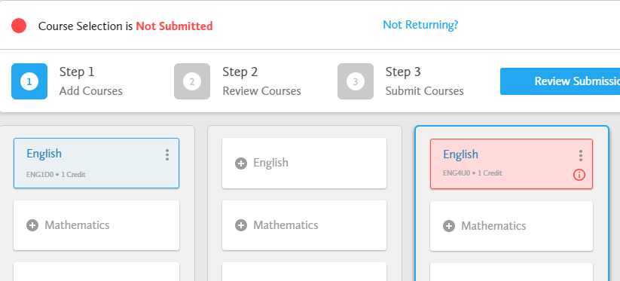
Missing Prerequisite Notification
Missing prerequisites have a red indicator and are highlighted in pink
Please review your course prerequisites.
See your Guidance Counsellor to develop a plan.

Slide 24
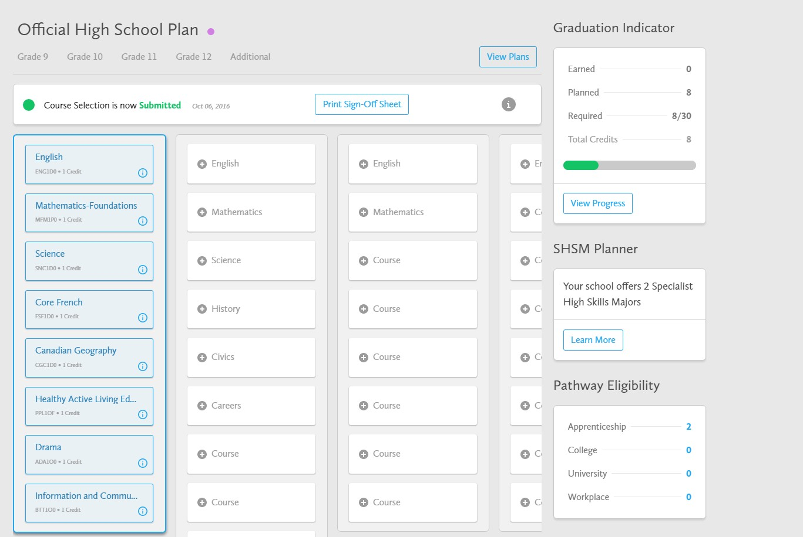
Submit Course Selection (Step 3)
You want to ensure you see the green text indicating your courses have been submitted
Last Step: Submit and Print Verification Form

Slide 25
Ensure you have Planned and Researched before Submitting
Students are responsible for going to myBlueprint.ca/dpcdsb and choosing their courses by January 10th
Courses only run with sufficient enrollment so please be sure to choose an alternate course.

Slide 26
Questions?
Speak to your parents/guardians
Reach out to your counsellor via Google Classroom or in Guidance
    A-C Mrs. Mazzone-Nizic
    D-F Mr. De Marco
    G-N Ms. Johnston
    O-Z Mrs. Lees
If you are booking an appointment, be sure to pick up your slip from guidance the next day!
Research! Research! Research!

Slide 27

Post Secondary Preparation
www.ontariocolleges.ca
www.ontariouniversitiesinfo.ca
www.myblueprint.ca/dpcdsb
www.apprenticesearch.ca
56

Slide 28

REMEMBER!
myBlueprint is OPEN for submission of next years courses
Courses must be submitted by January 10th

