Slide 1

Moving to Grade 10
St. Martin C.S.S Educational Planning
2024-2025

Slide 2






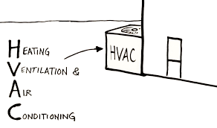
Pathways to Opportunity
What can you see yourself enjoying while being able to earn an income?

Slide 3
Our Goal is to Help you Plan for Success!
What does this look like?
  Completion of the Ontario Secondary School Diploma requirements (OSSD)
  Pursuing a Post-Secondary education
  Going to work directly from St. Martin
  Taking a GAP year
Ensuring eligibility to study what you want, where you want:
  Apprenticeship
  College
  University

Slide 4

Pathways
Students in Ontario have many options for post secondary training
You can choose from many colleges, universities, many private career colleges, or multiple apprenticeship opportunities and on the job training programs across the province and country

Slide 5

Compulsory Courses for Grade 10
RELIGION→ open
ENGLISH→ D, L, P
MATH→ D, L, P
SCIENCE→ D, P
HISTORY→ D, L, P
CIVICS (half credit)→ open
CAREERS (half credit)→ open
ELECTIVE CHOICES (pick 2) ARTS, PHYSICAL EDUCATION, TECHNOLOGY, BUSINESS
** REGIONAL SPORTS STUDENTS CHOOSE YOUR PACKAGE (HOCK, COURT, SOC, BATS, REG WHICH INCLUDES YOUR CIVCAR) AND 1 ELECTIVE **

Slide 6
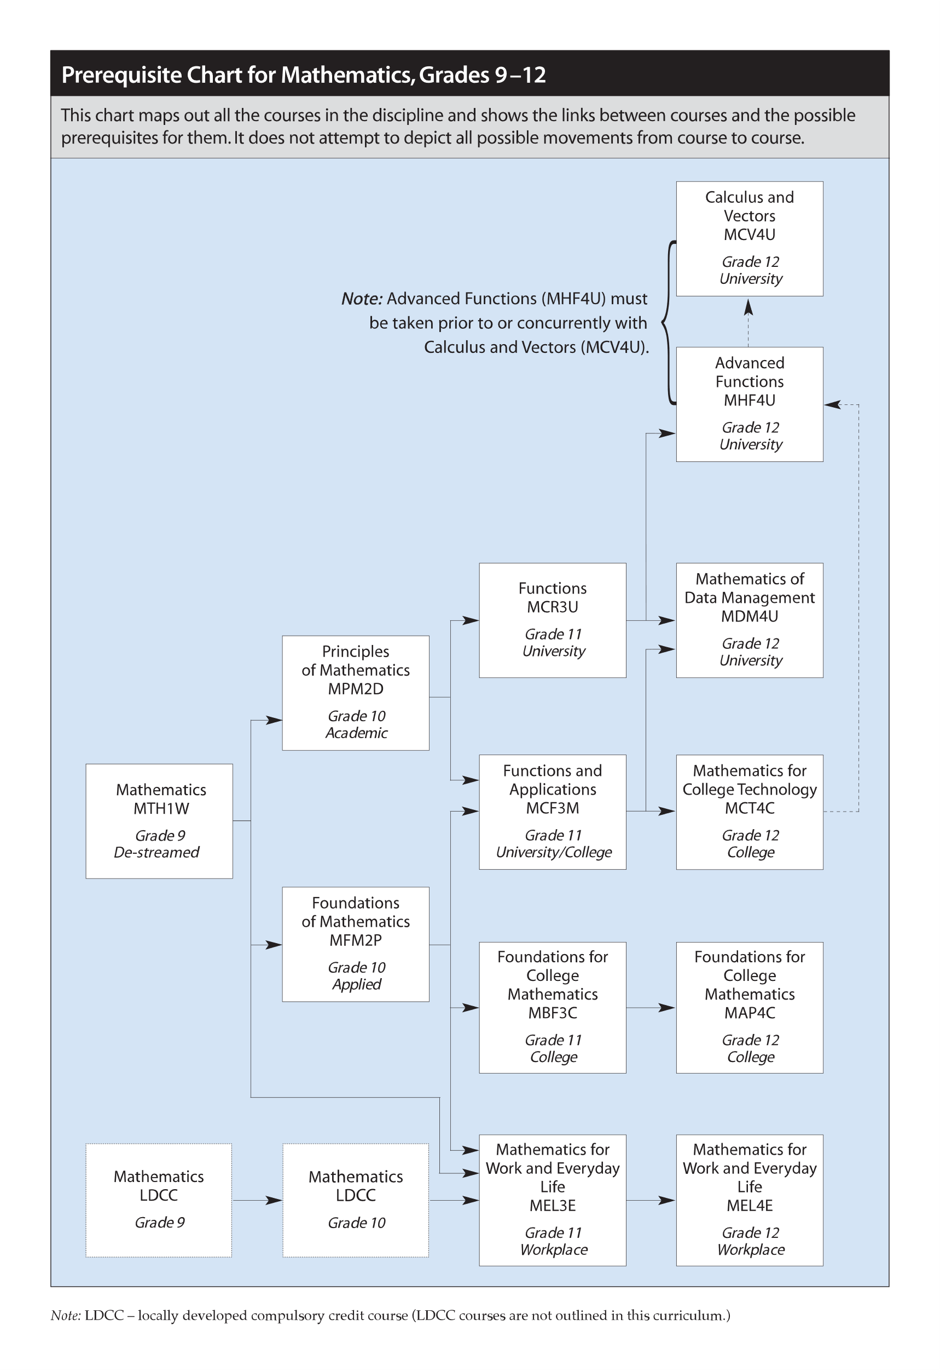

Slide 7
Course Levels
As well as choosing specific courses you also need to choose APPROPRIATE LEVELS
  Academic (D) at least 70% in grade 9 subject
  Applied (P)
  Locally Developed (L)
  Open (O)
TALK to your Parents/Teachers/Guidance Counsellor
LOOK at PRE-REQUISITES (what will you need for post-secondary plans?)

Slide 8

Summer School
If you are 100% certain that you are going to take a course in summer school, do not choose it as part of your plan for next year in myBlueprint
Add this information to the notes section in myBlueprint

Slide 9
Other Helpful Tips
If you are planning to transfer schools, select courses now and they will transfer to your new school once you register

Slide 10

myBlueprint Access
Using Google Chrome, you can access it from your Dashboard

Slide 11
If you are NEW to DPCDSB
http://www.myBlueprint.ca/dpcdsb Using Google Chrome
You will need your:
Date of Birth
OEN
  Ontario Education Number (OEN). Find this on:
    Your student card
    Your report cards
    Your timetable
    Or come to Guidance
Note: In order to select and submit courses, you MUST use your OEN the first time you login to myBlueprint.

Slide 12
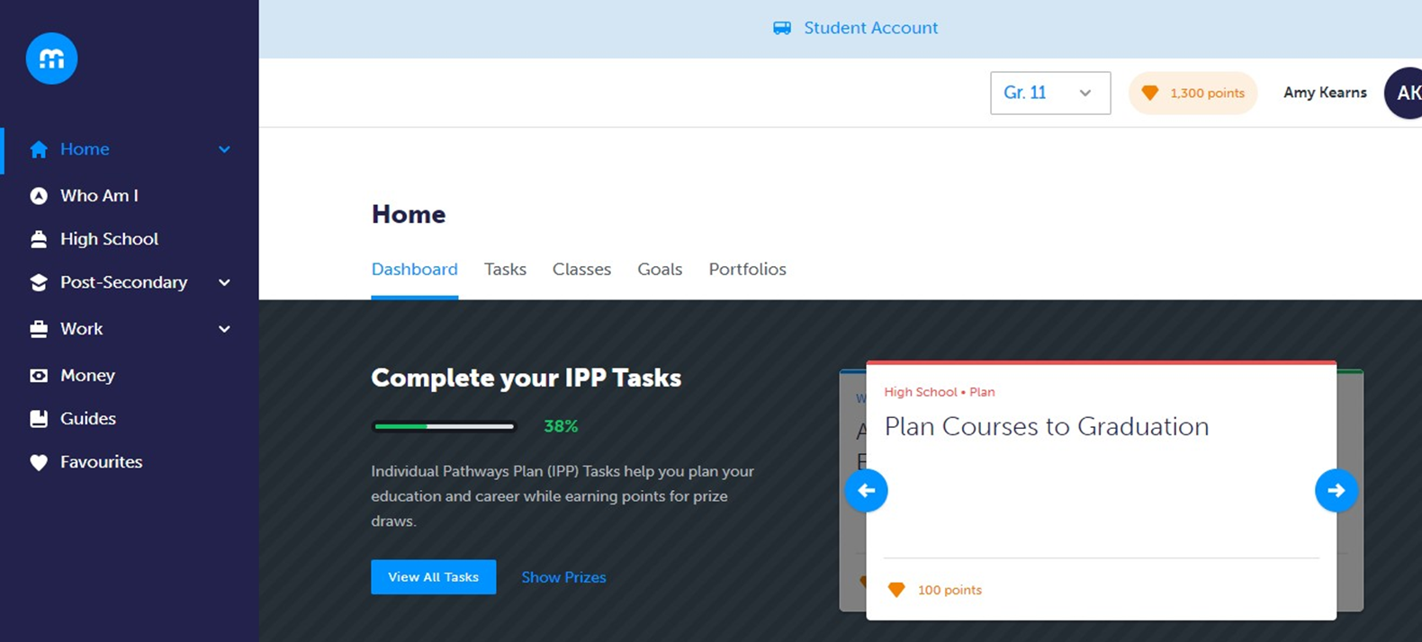
Plan Your Courses Using myBlueprint High School Planner

Slide 13
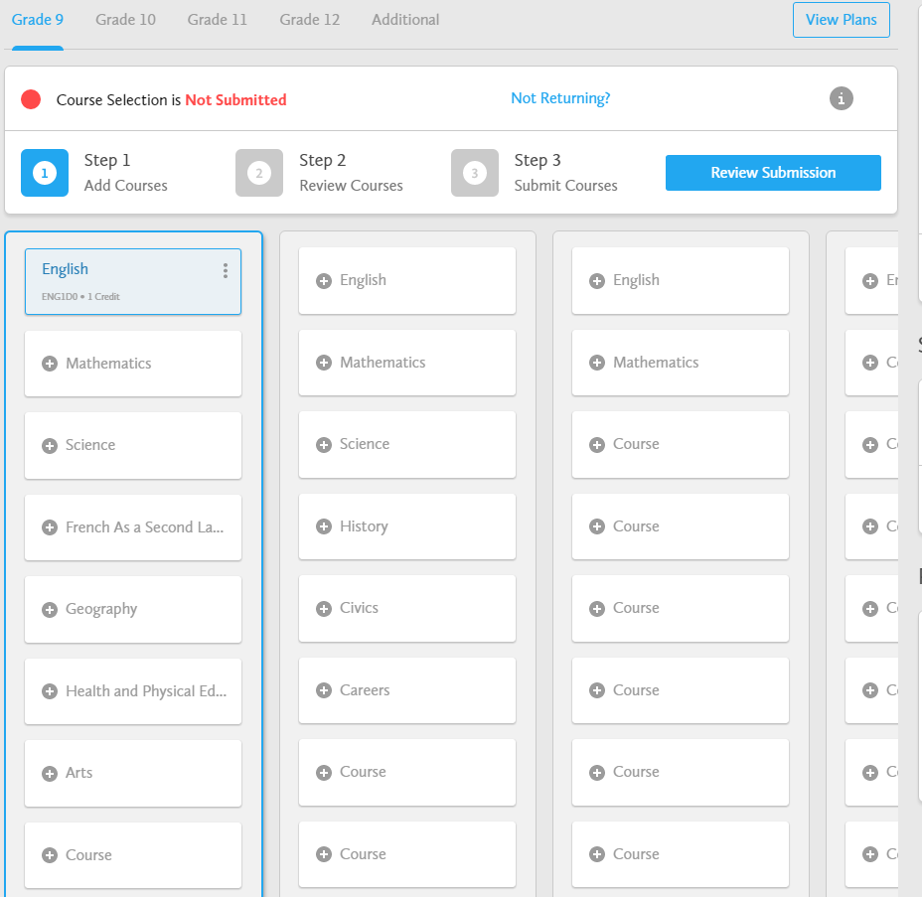
Course Selection Process
Choose courses using the suggested subjects
Regional Sports students DO NOT select Civics and Careers. You choose your package HOCK, BATS, COURT, SOC, REG and it includes CIVCAR!

Slide 14
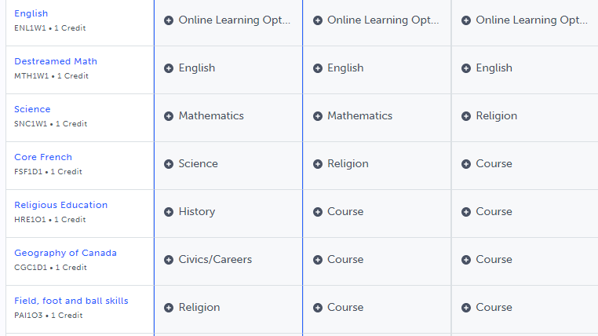
eLearning Opt-Out
To OPT-OUT of the 2 Ministry mandated eLearning courses, please add the option at the top of your grade 10 year.

Slide 15
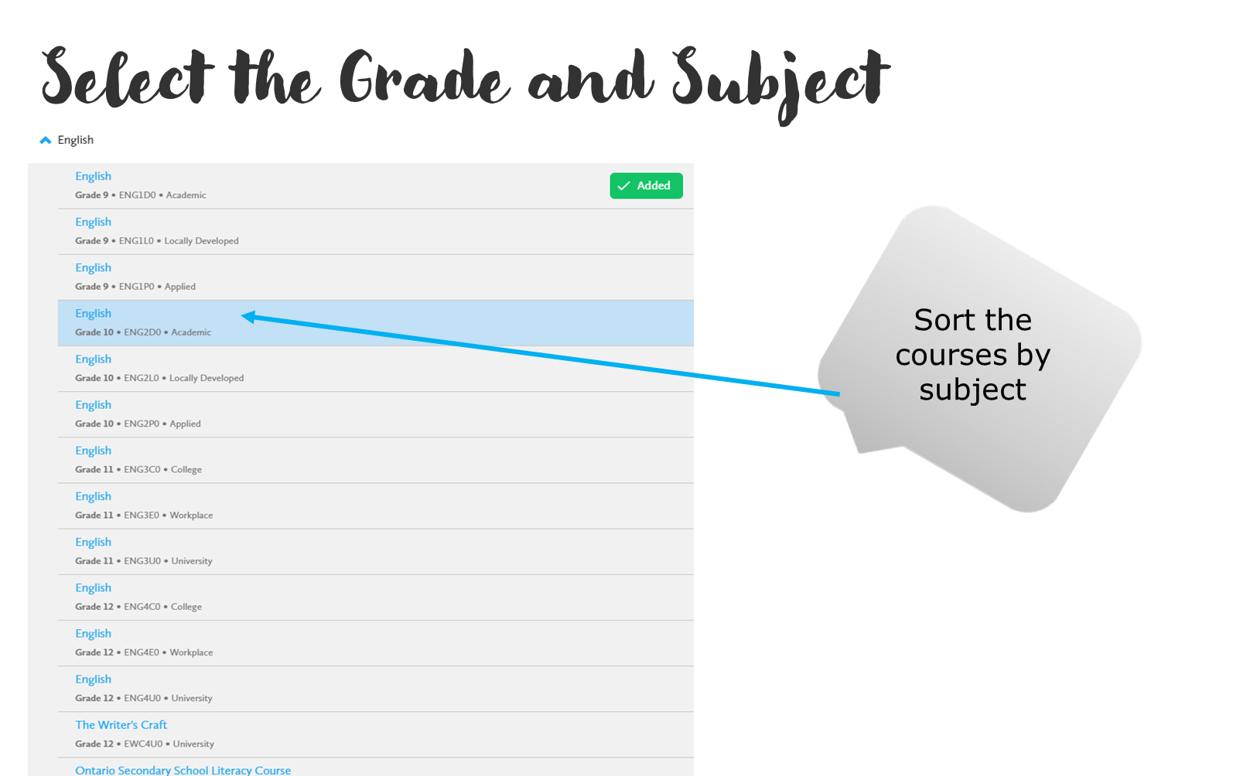

Slide 16
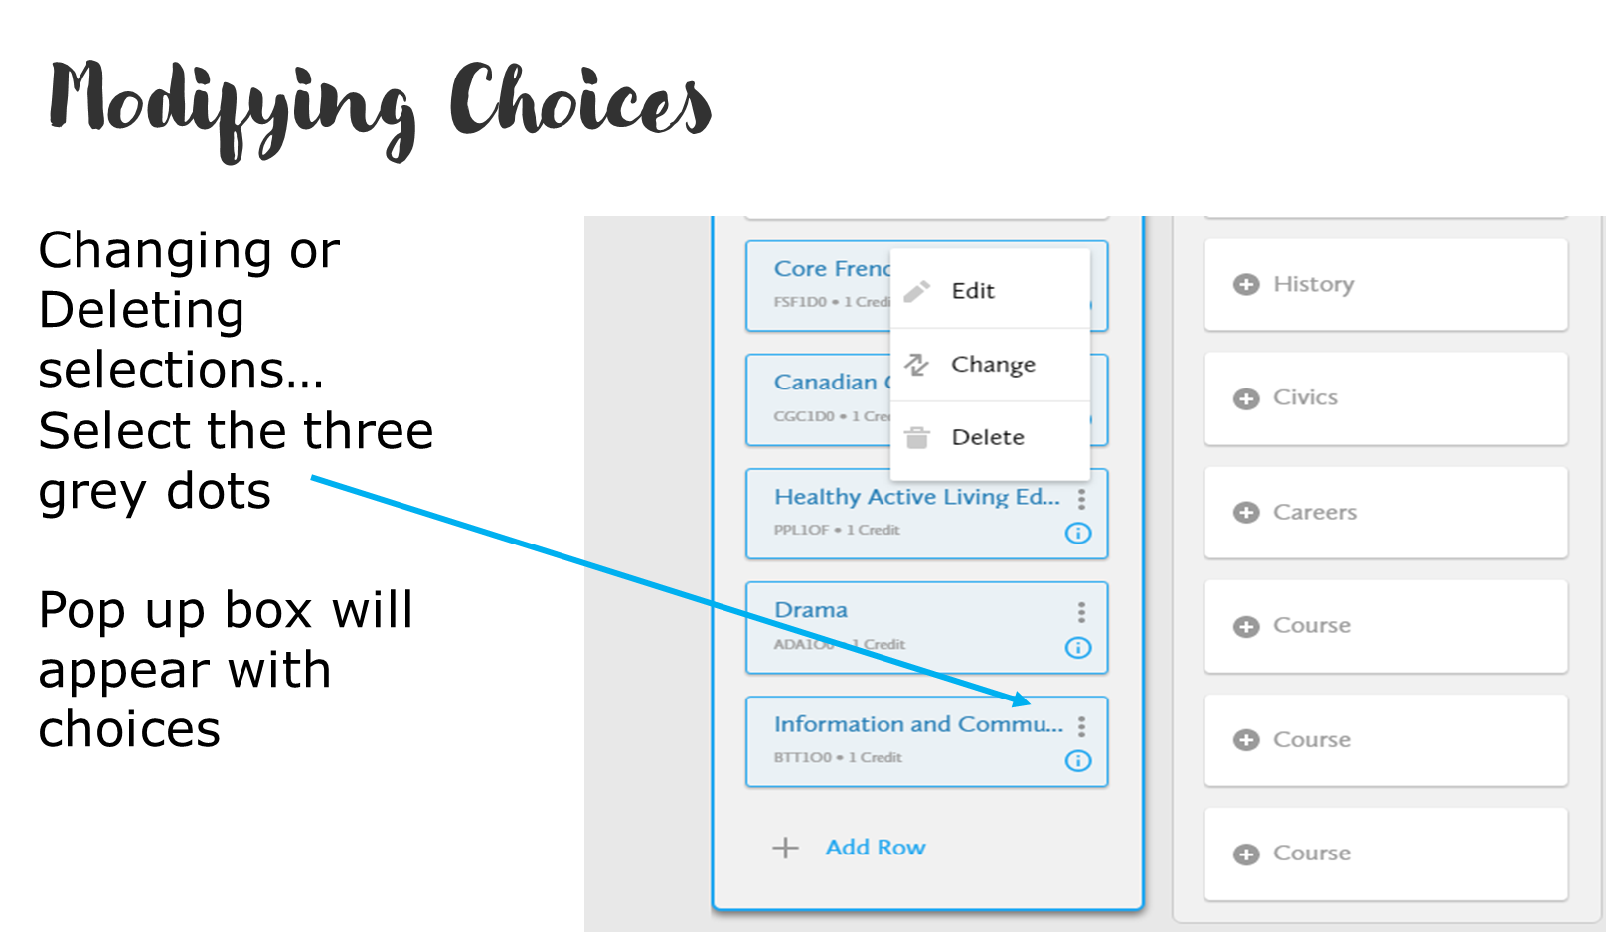

Slide 17
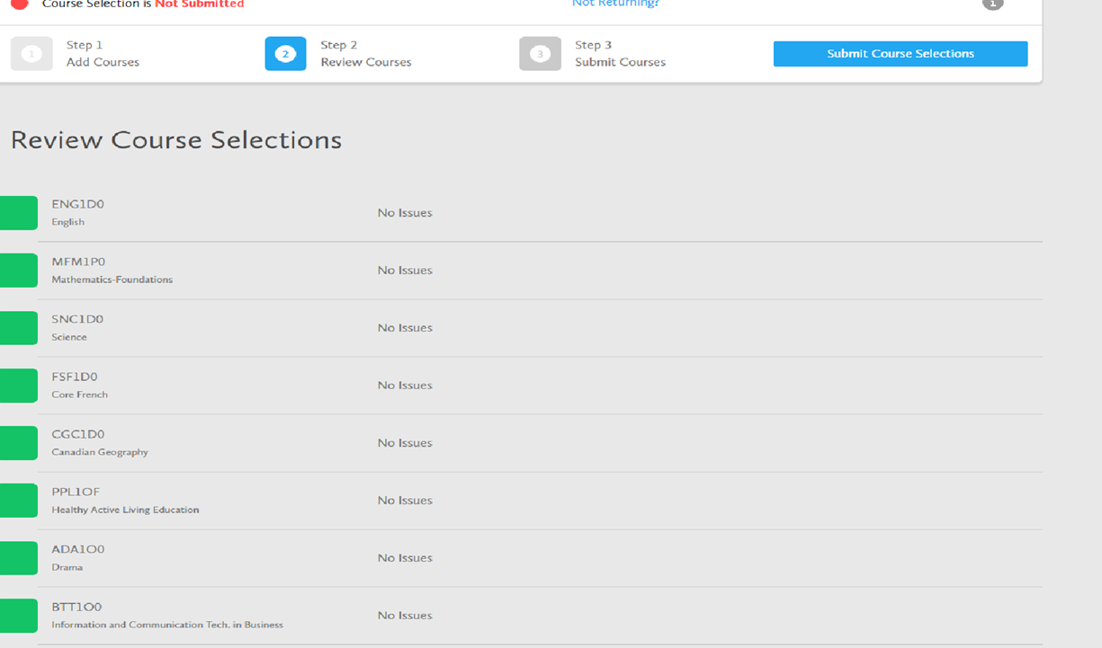
Review Course Selection
Review details and issues

Slide 18
Review Course Selection (Part 2)
Issues that are identified can still be updated BEFORE YOU SUBMIT!
Not all issues that are identified need to be altered
    e.g. ESLBO does not need ESLAO as a prerequisite.
You can add comments to the plan, such as Summer School plans for ENG2P

Slide 19
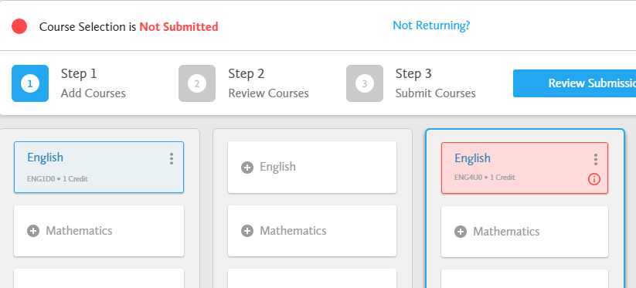

Missing Prerequisite Notification
Please review your course prerequisites.
See your Guidance Counsellor to develop a plan.
Missing prerequisites have a red indicator and are highlighted in pink

Slide 20
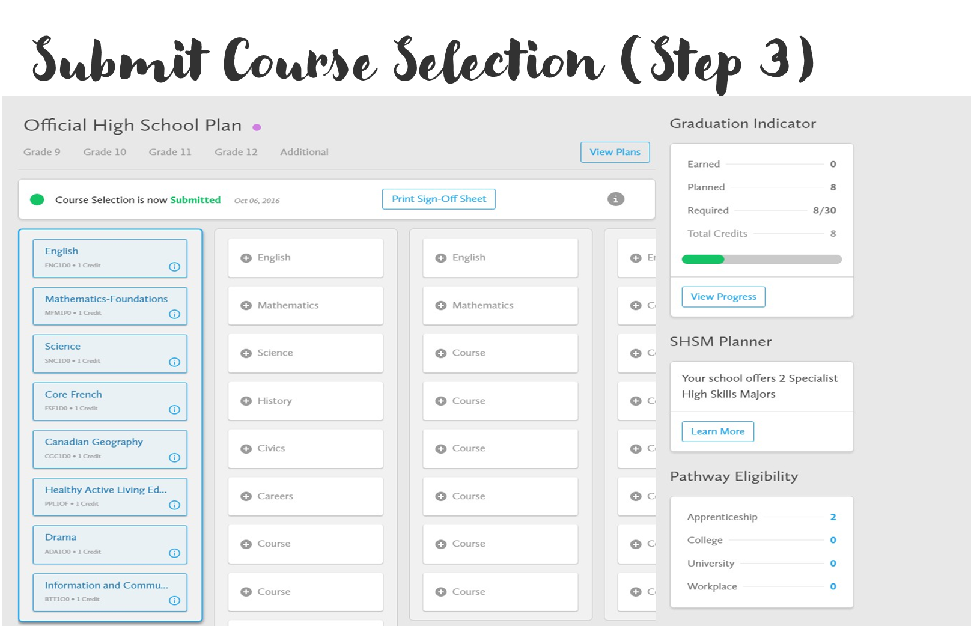
Last Step: Submit and Print Verification Form

Slide 21
Plan, Plan, Plan and then SUBMIT!
Students are responsible for going on to myBlueprint.ca/dpcdsb and choosing their courses by January 10th!
Courses only run with sufficient enrollment – Please choose an alternate course.

Slide 22
Questions?
Speak to your teachers
Speak to your parents/guardians
Reach out to your counsellor via Google Classroom
  A-C Mrs. Mazzone-Nizic
  D-F Mr. DeMarco
  G-N Ms. Johnston
  O-Z Mrs. Lees
If you are booking a guidance appointment, make sure to come back the next morning to pick up your appointment slip!
RESEARCH! RESEARCH! RESEARCH!

Slide 23
Remember!
myBlueprint will be open tomorrow for course selection
You can access it through your student dashboard via Google Chrome
Ensure you review your choices and click SUBMIT!

